Slide 2
The Ethernet Specifications

Slide 3
Table of Contents
Ethernet Basics
Ethernet as the Data Link Layer

Slide 4
Ethernet Basics
1

Slide 5
Ethernet Basics
Ethernet
The technology for connecting devices in a network
Describes how network devices can format and transmit data
Uses both Data Link and Physical layer specifications
Electrical and Electronics Engineers (IEEE) defines Ethernet as protocol 802.3
Notes:
Ethernet is the traditional technology for connecting devices in a wired local area network (LAN), enabling them to communicate with each other via a protocol -- a set of rules or common network language. Ethernet describes how network devices can format and transmit data so other devices on the same local or campus area network segment can recognize, receive and process the information. An Ethernet cable is the physical, encased wiring over which the data travels.
Connected devices accessing a geographically localized network with a cable -- that is, with a wired rather than wireless connection -- likely use Ethernet. From businesses to gamers, diverse end users depend on the benefits of Ethernet connectivity, which include reliability and security.
Compared to wireless LAN (WLAN) technology, Ethernet is typically less vulnerable to disruptions. It can also offer a greater degree of network security and control than wireless technology since devices must connect using physical cabling. This makes it difficult for outsiders to access network data or hijack bandwidth for unsanctioned devices.

Slide 6
Ethernet Basics
Ethernet
Bandwidth | Common Name | Informal name | IEEE name | Cable Type
10 Mbps | Ethernet | 10Base-T | 802.3 | UTP 100m
100 Mbps | Fast Ethernet | 100Base-T | 802.3u | UTP 100m
1000 Mbps | Gigabit Ethernet | 1000Base-LX | 802.3z | Fiber 5000m
1000 Mbps | Gigabit Ethernet | 1000Base-T | 802.3ab | UTP 100m
10 Gbps | 10 Gigabit Ethernet | 10GBase-T | 802.3an | UTP 100m
Notes:
An overview of some popular Ethernet standards

Slide 7
Ethernet Basics
Collision Domain
The term collision domain is used to describe a part of a network where packet collisions can occur
Collisions occur when two devices on a shared network segment send packets simultaneously
The colliding packets must be discarded and sent again, which reduces network efficiency
Notes:
The term collision domain is used to describe a part of a network where packet collisions can occur. Packet collisions occur when two devices on a shared network segment send packets simultaneously. The colliding packets must be discarded and sent again, which reduces network efficiency.

Slide 8
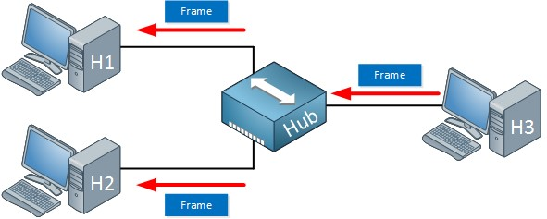
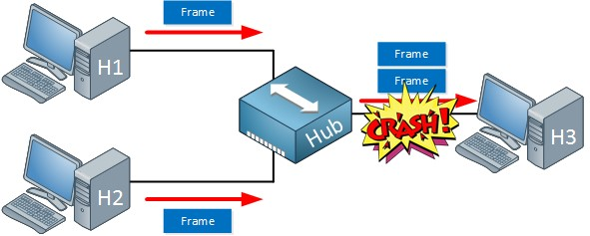
Ethernet Basics
Collision Domain
Occurs often in a hub environment
1
2
Notes:
Collisions occur often in a hub environment because all devices connected to the hub are in the same collision domain. Only one device may transmit at time, and all the other devices connected to the hub must listen to the network in order to avoid collisions. Total network bandwidth is shared among all devices.
In contrast to hubs, every port on a bridge, switch, or a router is in a separate collision domain. This eliminates the possibility of collisions and enables the devices to use the full-duplex mode of communication, which effectively doubles the maximum data capacity.

Slide 9
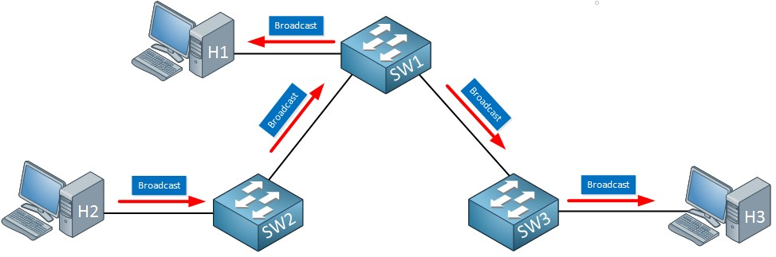
Ethernet Basics
Broadcast Domain
A broadcast domain is a collection of network devices that receive broadcast traffic from each other
1 broadcast domain
Notes:
A broadcast domain is a collection of network devices that receive broadcast traffic from each other.
All the devices present in broadcast domain have to pay attention to it. This creates a lot of congestion in the network, commonly called LAN congestion, which affects the bandwidth of the users present in that network.

Slide 10
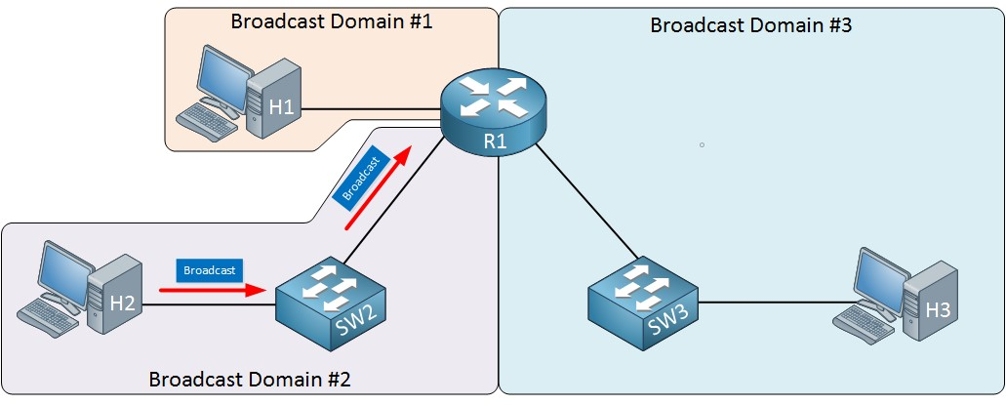
Ethernet Basics
Broadcast Domain
The more broadcast domains the more efficient network
Notes:
From this, we can realize that more the number of collision domains and more the number of broadcast domains, the more efficient is the network providing better bandwidth to all its users.
You can divide one big broadcast domain into smaller ones by using a router. We will talk about what a router is and what it does in the Network Devices lesson.

Slide 11
Ethernet Basics
CSMA/CD
Carrier Sense Multiple Access/Collision Detection is the protocol that is used to detect collisions and to re-transmit frames
Only bridges, switches, and routers, but not hubs, can effectively prevent a transmission from propagating throughout the entire network
Notes:
As we said earlier, everything that is connected to a hub is a single collision domain. Because of these collisions, we have to use half duplex. We can’t send and transmit at the same time. CSMA/CD is the protocol that is used to detect collisions and to re-transmit frames.
CSMA/CD is a simple protocol. All computers to the network will listen to see if someone is transmitting. When we want to send something and nobody is transmitting, we can transmit a frame. This is half duplex; we can’t transmit and receive at the same time. When two computers decide they can transmit, we still get a collision. CSMA/CD also describes how we can re-transmit a frame.
CSMA/CD is done by our computers but not by the hub; it’s only a dumb physical repeater.
When a host wants to transmit over the network, it first checks for the presence of a digital signal on the wire. If all is clear, meaning that no other host is transmitting, the host will then proceed with its transmission. But it doesn’t stop there. The transmitting host constantly monitors the wire to make sure no other hosts begin transmitting. If the host detects another signal on the wire, it sends out an extended jam signal that causes all hosts on the segment to stop sending data (think busy signal). The hosts respond to that jam signal by waiting a while before attempting to transmit again. Backoff algorithms, represented by the clocks counting down on either side of the jammed devices, determine when the colliding stations can retransmit. If collisions keep occurring after 15 tries, the hosts attempting to transmit will then time out.

Slide 12
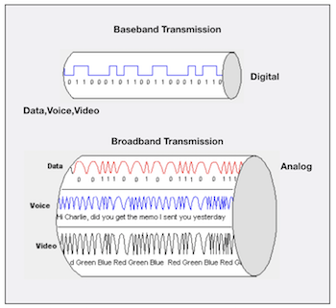
Ethernet Basics
Broadband/Baseband
Baseband
- Uses digital signals and single
channel
- Communication is bidirectional
- Short distance
Broadband
- Uses analog signals
- Multiple transmissions are possible
- Communication is unidirectional
- Long distance
Notes:
In Baseband, data is sent as digital signals through the media as a single channel that uses the entire bandwidth of the media. Baseband communication is bi-directional, which means that the same channel can be used to send and receive signals.
Broadband sends information in the form of an analog signal. Each transmission is assigned to a portion of the bandwidth, hence multiple transmissions are possible at the same time. Broadband communication is unidirectional, so in order to send and receive, two pathways are needed. This can be accomplished either by assigning a frequency for sending and assigning a frequency for receiving along the same cable or by using two cables, one for sending and one for receiving.
Baseband is used for short distance data transfer. Entire bandwidth of the cable is used for single signal transmission. Common Ethernet Standards use Baseband for LAN data transfer.
Broadband is used for long distance data transfer. Entire bandwidth of the cable is used for multiple signal transmission at different frequencies. Home Internet connection and TV cables use broadband for data transfer.
If you are using a broadband internet connection for your home internet, the signals from your internet service provider up to your broadband router are broadband signals. But, the signals used inside your Ethernet Local Area Network (LAN) are baseband signals.

Slide 13
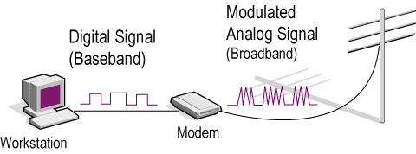
Ethernet Basics
Broadband/Baseband
If you are using a broadband internet connection for your home internet, the signals from your ISP up to your broadband router are broadband signals. But, the signals used inside your Ethernet LAN are baseband signals.
Notes:
If you are using a broadband internet connection for your home internet, the signals from your internet service provider up to your broadband router are broadband signals. But, the signals used inside your Ethernet Local Area Network (LAN) are baseband signals.

Slide 14
Ethernet at the Data Link Layer
2

Slide 15
Ethernet at the Data Link Layer
Binary to Decimal and Hexadecimal Conversion
Ethernet at the Data Link layer is responsible for:
Ethernet addressing (hardware or MAC addressing)
framing packets received from the Network layer
Ethernet MAC addresses are made up of hexadecimal addresses
Notes:
Ethernet at the Data Link layer is responsible for Ethernet addressing, commonly referred to as hardware addressing or MAC addressing. Ethernet is also responsible for framing packets received from the Network layer and preparing them for transmission on the local network through the Ethernet contention media-access method known as CSMA/CD.
Ethernet MAC addresses are made up of hexadecimal addresses.

Slide 16
Ethernet at the Data Link Layer
Binary to Decimal and Hexadecimal Conversion
1 bit
1 nibble
4 bits
1
0
1 byte
8 bits
Notes:
Understanding the differences between binary, decimal, and hexadecimal numbers and how to convert one format into the other is very important before discussing the TCP/IP protocol stack and IP addressing in further. So let’s get started with binary numbering. You already know that one bit is either a 1 (one) or a 0 (zero). Typically, you count either 4 or 8 bits together, with these being referred to as a nibble and a byte, respectively.

Slide 17
Ethernet at the Data Link Layer
Binary to Decimal Conversion
Binary Value | Decimal Value
10000000 | 128
11000000 | 192
11100000 | 224
11110000 | 240
11111000 | 248
11111100 | 252
11111110 | 254
11111111 | 255
Notes:
It is strongly advised that you memorize the table before braving the IP sections in further lessons since this lists all available subnet masks.
This table shows binary to decimal conversion

Slide 18
Ethernet at the Data Link Layer
Binary to Decimal and Hexadecimal Conversion
Binary Value | Hexadecimal Value | Decimal Value
0000 | 0 | 0
0001 | 1 | 1
0010 | 2 | 2
0011 | 3 | 3
0100 | 4 | 4
0101 | 5 | 5
0110 | 6 | 6
0111 | 7 | 7
Binary Value | Hexadecimal Value | Decimal Value
1000 | 8 | 8
1001 | 9 | 9
1010 | A | 10
1011 | B | 11
1100 | C | 12
1101 | D | 13
1110 | E | 14
1111 | F | 15
Notes:
Hexadecimal addressing is completely different than binary or decimal—it’s converted by reading nibbles, not bytes. By using a nibble, we can convert these bits to hex pretty simply. First, understand that the hexadecimal addressing scheme uses only the numbers 0 through 9. And because the numbers 10, 11, 12, and so on can’t be used (because they are two-digit numbers), the letters A, B, C, D, E, and F are used to represent 10, 11, 12, 13, 14, and 15, respectively.

Slide 19
Ethernet at the Data Link Layer
Binary to Decimal and Hexadecimal Conversion
Example:
What is the binary value of 0x4E (or 4Eh)?
(0x and h means that the value is hexadecimal or hex)
binary:
4 = 0100
E = 1110
01001110

Slide 20
Binary to Decimal and Hexadecimal Conversion
What is the binary value of 27h?
Ethernet at the Data Link Layer
Notes:
🍐 This is a Pear Deck Text Slide
🍐 To edit the type of question, go back to the "Ask Students a Question" in the Pear Deck sidebar.
Transition Template
Transitions between class periods or between activities within a class period can be times for confusion and chaos - it’s an easy time for students to become distracted, and before you know it, you’ve lost their attention. Help students know what to expect by using this slide to articulate clear steps for wrapping up one activity and prepare for the next. Try to keep the list to no more than three steps if you can.
Answer is: 0010 0111

Slide 21
Binary to Decimal and Hexadecimal Conversion
What is the binary value of 0xF9?
Ethernet at the Data Link Layer
Notes:
🍐 This is a Pear Deck Text Slide
🍐 To edit the type of question, go back to the "Ask Students a Question" in the Pear Deck sidebar.
Transition Template
Transitions between class periods or between activities within a class period can be times for confusion and chaos - it’s an easy time for students to become distracted, and before you know it, you’ve lost their attention. Help students know what to expect by using this slide to articulate clear steps for wrapping up one activity and prepare for the next. Try to keep the list to no more than three steps if you can.
Answer is: 1111 1001

Slide 22
Ethernet at the Data Link Layer
Ethernet Addressing
MAC (Media Access Control) Address
48-bit (6 bytes or 12-digit hex) hardware number
unique
embedded into the network card, not changeable
represented as 00:1A:3F:D3:2C:11 or 00-1A-3F-D3-2C-11
00 | 1A | 3F | D3 | 2C | 11
Organizationally Unique Identifier (OUI) Network Interface Controller Specific
Notes:
Ethernet addresses are called MAC (Media Access Control) addresses. Each network device has a unique MAC address. When we send an Ethernet frame, we add our own MAC address as the source and the receiver MAC address as the destination.
MAC Addresses are unique 48-bits hardware number of a computer, which is embedded into the network card (known as Network Interface Card) during the time of manufacturing. MAC Address is also known as the Physical Address of a network device.
https://standards.ieee.org/products-services/regauth/oui/index.html

Slide 23
Ethernet at the Data Link Layer
Types of MAC Address
1. Unicast:
A specific NIC on the network
Only one sender and only one receiver
Notes:
Unicast MAC address represents a specific NIC or onboard NIC ports in the network. The inbuilt MAC address of a NIC is the unicast MAC address of that NIC.
In Unicast type of communication, there is only one sender, and only one receiver.

Slide 24
Ethernet at the Data Link Layer
Types of MAC Address
2. Multicast:
A group of receivers
OUI is 01:00:5E
Notes:
Multicast is a type of communication where multicast traffic addressed for a group of devices on the network

Slide 25
Ethernet at the Data Link Layer
Types of MAC Address
3. Broadcast:
All devices on the network are recipients
MAC Address is:
FF:FF:FF:FF:FF:FF
Notes:
Broadcast MAC address represents all devices in the network. The IEEE has reserved the address FFFF.FFFF.FFFF as the broadcast MAC address. Any device that wants to send the data to all devices of the network, can use this address as the destination MAC address.

Slide 26
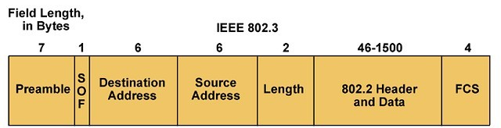
Ethernet at the Data Link Layer
Ethernet Frames
Encapsulated data defined by the Network Access layer is called an Ethernet frame
The Ethernet frame structure is defined in the IEEE 802.3 standard
Notes:
In an Ethernet network, devices share data using packets. They contain, among other things, the Ethernet frame, which is divided into several data sets. These records consist of binary code that provides important information, such as addresses, control information, payload data, and checksums.
Depending on the Ethernet standard, Ethernet frames are structured differently and may contain more or fewer data fields, depending on the network protocol.
It’s not crucial to know the contents of the Ethernet frame. But in case some of you wonder, I’ll simply put the contents.
PREAMBLE – Ethernet frame starts with 7-Bytes Preamble. This is a pattern of alternative 0’s and 1’s which indicates starting of the frame and allow sender and receiver to establish bit synchronization. Initially, PRE (Preamble) was introduced to allow for the loss of a few bits due to signal delays. But today’s high-speed Ethernet don’t need Preamble to protect the frame bits. PRE (Preamble) indicates the receiver that frame is coming and allow the receiver to lock onto the data stream before the actual frame begins.
Start of frame delimiter (SFD or SOF) – This is a 1-Byte field which is always set to 10101011. SFD indicates that upcoming bits are starting of the frame, which is the destination address. Sometimes SFD is considered the part of PRE, this is the reason Preamble is described as 8 Bytes in many places. The SFD warns station or stations that this is the last chance for synchronization.
Destination Address – This is 6-Byte field which contains the MAC address of machine for which data is destined.
Source Address – This is a 6-Byte field which contains the MAC address of source machine. As Source Address is always an individual address (Unicast), the least significant bit of first byte is always 0.
Length – Length is a 2-Byte field, which indicates the length of entire Ethernet frame. This 16-bit field can hold the length value between 0 to 65534, but length cannot be larger than 1500 because of some own limitations of Ethernet.
Data – This is the place where actual data is inserted, also known as Payload. Both IP header and data will be inserted here if Internet Protocol is used over Ethernet. The maximum data present may be as long as 1500 Bytes. In case data length is less than minimum length i.e. 46 bytes, then padding 0’s is added to meet the minimum possible length.
Frame Check Sequence (FCS or Cyclic Redundancy Check (CRC)) – CRC is 4 Byte field. This field contains a 32-bits hash code of data, which is generated over the Destination Address, Source Address, Length, and Data field. If the checksum computed by destination is not the same as sent checksum value, data received is corrupted.

Slide 27
THANKS!
Any questions?

